Slide 1


Slide 2
“We urge you, brethren, admonish the unruly, encourage the faint-hearted, help the weak, be patient with everyone.” 1 Thessalonians 5:14 NASB
Fall Out:
What’s Left Behind

Slide 3
Fall Out
What’s Left Behind

Slide 4
2 Peter 2:20-22
Fall Out:
What’s Left Behind

Slide 5

Falling Away from THE Faith
“…many will turn away from the faith…”
Matt. 24:10 NIV
One Faith
  Ephesians 4:4f
  John 14: 6

Slide 6
1 Samuel 2:29-31
Fall Out:
What’s Left Behind

Slide 7
Falling Away from THE Faith
“…many will turn away from the faith…”
Matt. 24:10 NIV
One Faith
  Ephesians 4:4f
  John 14: 6
It’s a Choice
  Matthew 24:9-10
  James 1:12-15

Slide 8
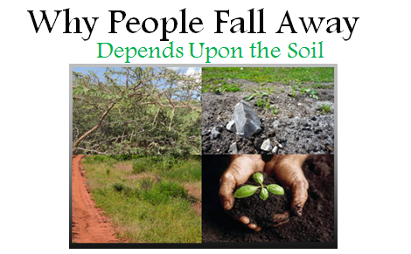
Why People Fall Away
A Lesson from the Master Teacher
  Matthew 13:1-9
  Matthew 13:18-23

Slide 9
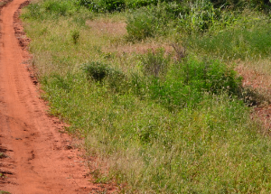
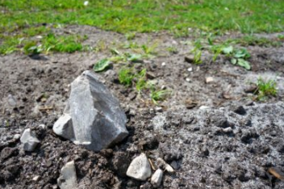
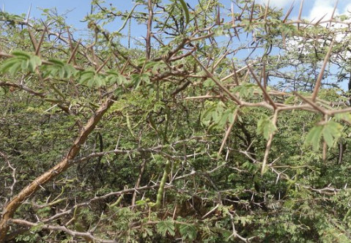
Why People Fall Away
Depends Upon the Soil
Trodden Soil v.19
  Unbelief
  False Doctrine
Rocky Soil v.20
  No Courage in Trials
  Can’t Endure Persecution
Thorn Choked Soil v.22
  Love of the World
  Cares & Concerns for Physical Things

Slide 10
What to Do About It
Crisis Points
  Elders Shepherd
  Members of Family
  Stay Alert
Be A Family
  Recognize Familial Bond
  Look Out for One Another
Experience Christianity
  Experience Bible
  Experience Prayer
  Experience Brotherhood

Slide 11
The Choice is Yours
Crisis Points
  Elders Shepherd
  Members of Family
  Stay Alert
Be A Family
  Recognize Familial Bond
  Look Out for One Another
Experience Christianity
  Experience Bible
  Experience Prayer
  Experience Brotherhood

Slide 12
Fall Out
What’s Left Behind

